Slide 1


Railway Relay
Ctrl Alt Defeat
28/05/2025
CTRL ALT DEFEAT
28 MAY 25

Slide 2
The Requirements
MOBILE FRIENDLY
REAL TIME UPDATES
CATEGORISATION
EASY INTEGRATION
SIMPLE UI

Slide 3
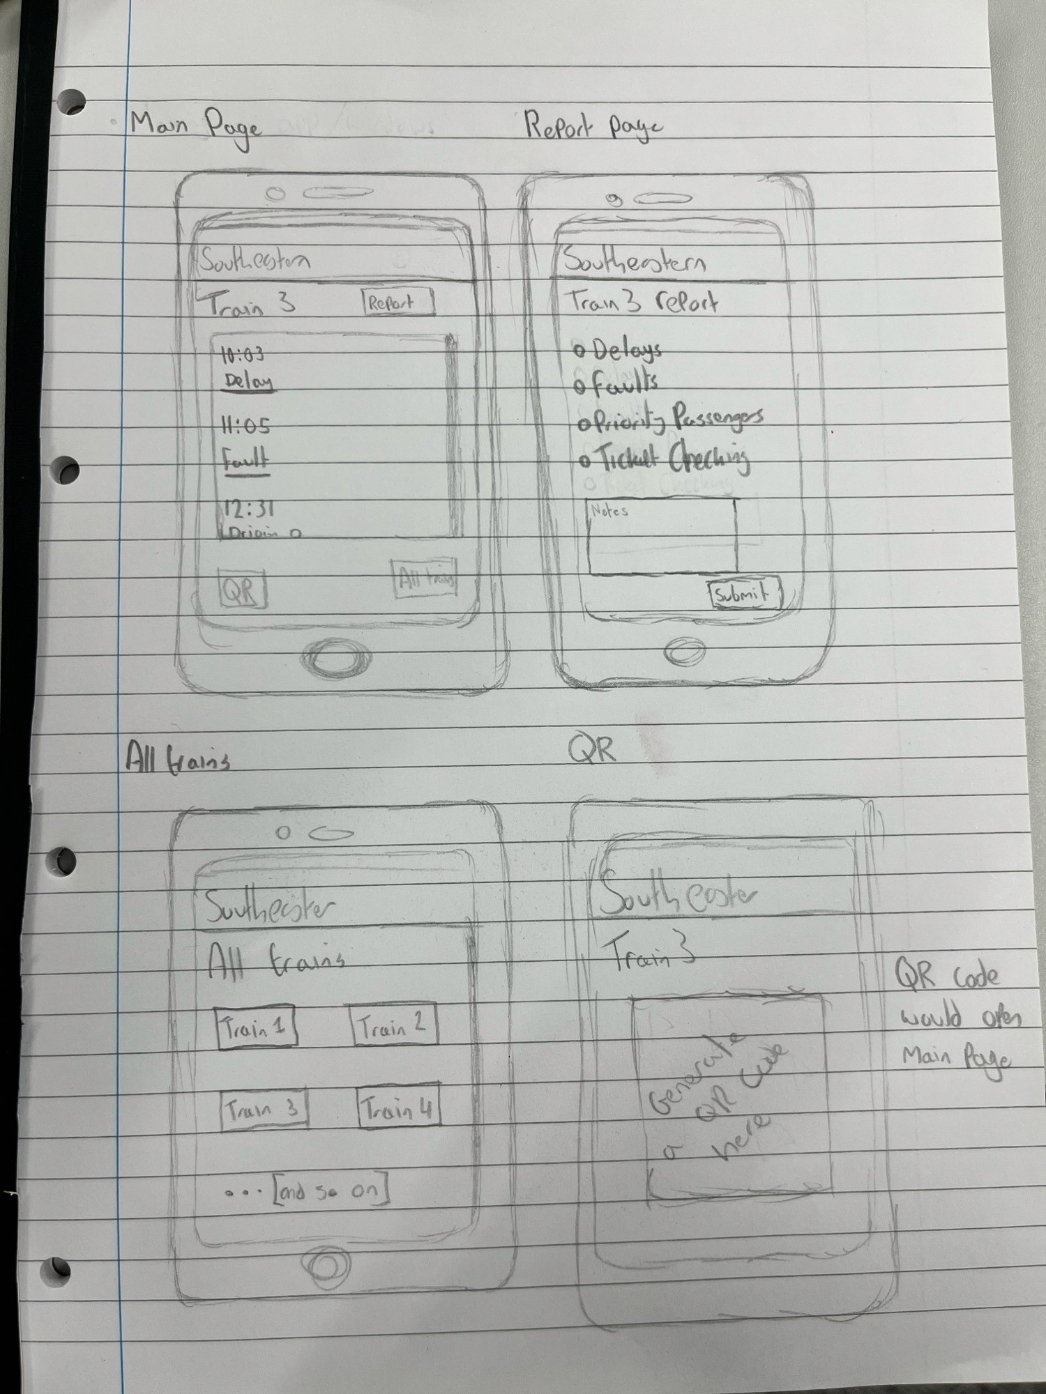
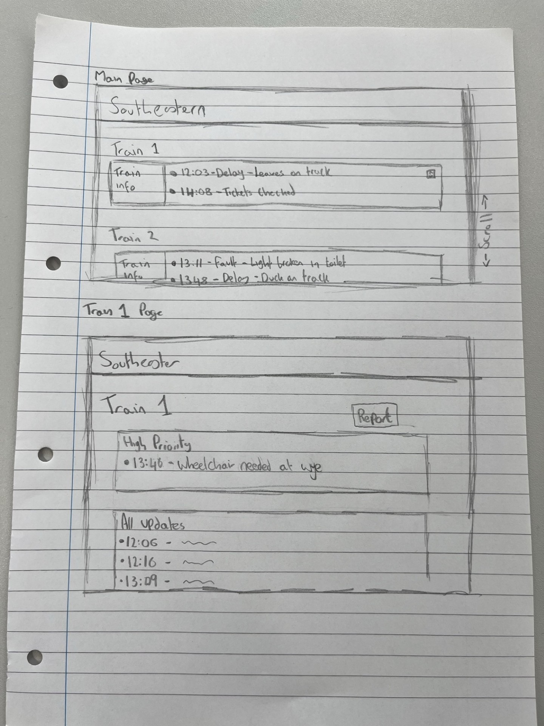
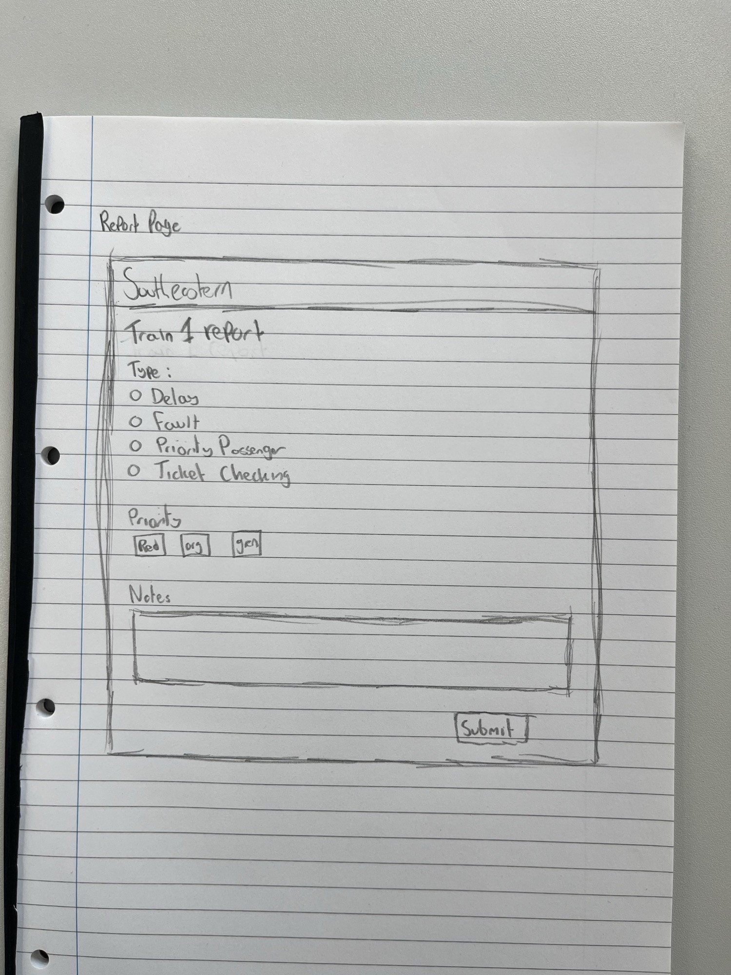
The Concept

Slide 4
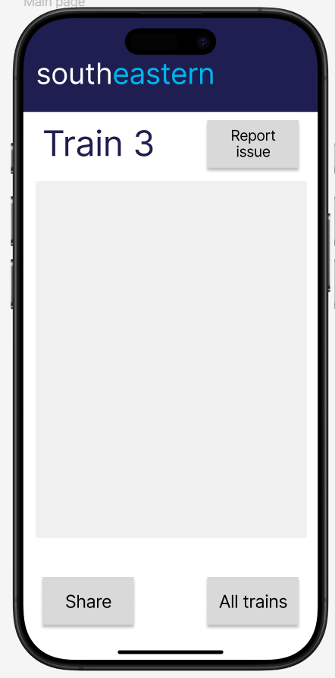
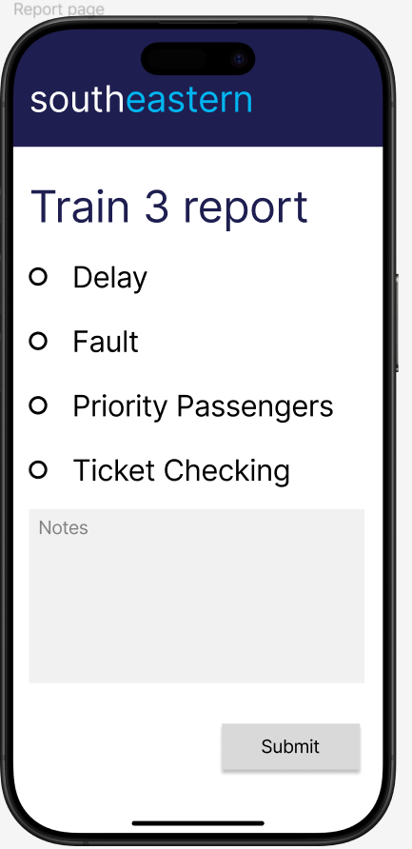
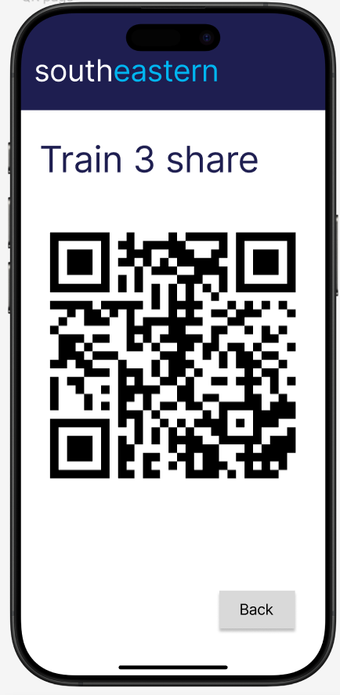
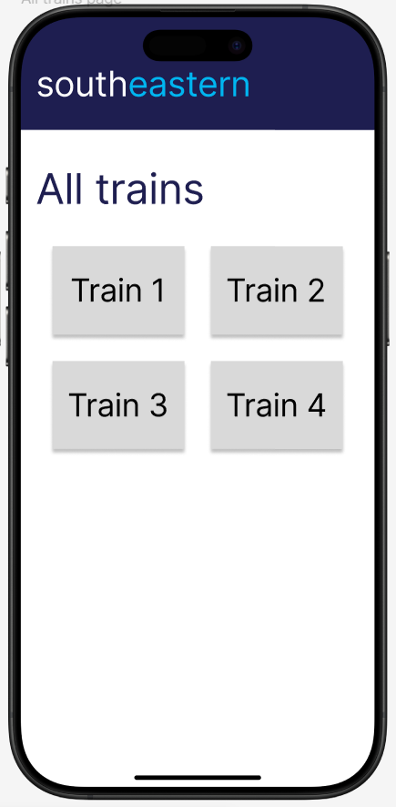
The Design- Mobile

Slide 5
Report
Issue
10:57 Leaves on track- 5 min delay
10:32 David Beckham in Car 1
10:28 Passenger in Car 3 requires assistance at Chillam
08:14 USB charger seat 52 Car 6 is broken
11:02 Tickets checked in Car 2
10:57 Leaves on track- 5 min delay
10:32 David Beckham in Car 1
10:28 Passenger in Car 3 requires assistance at Chillam
08:14 USB charger seat 52 Car 6 is broken
The Design Mobile
Train 3
Tickets checked in Car 2
Share
Submit

Slide 6
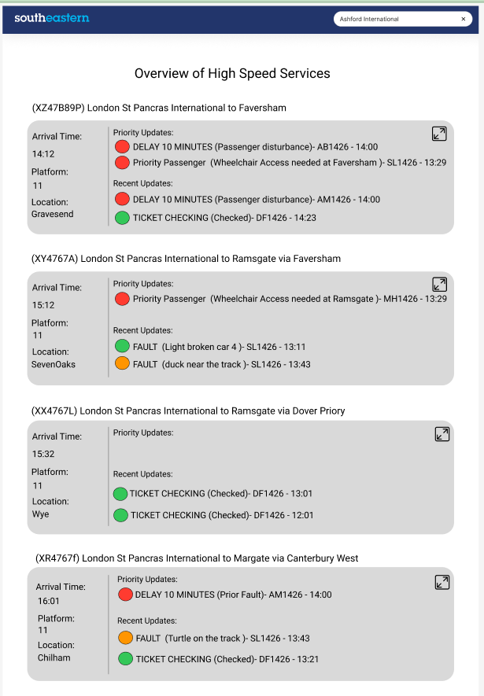
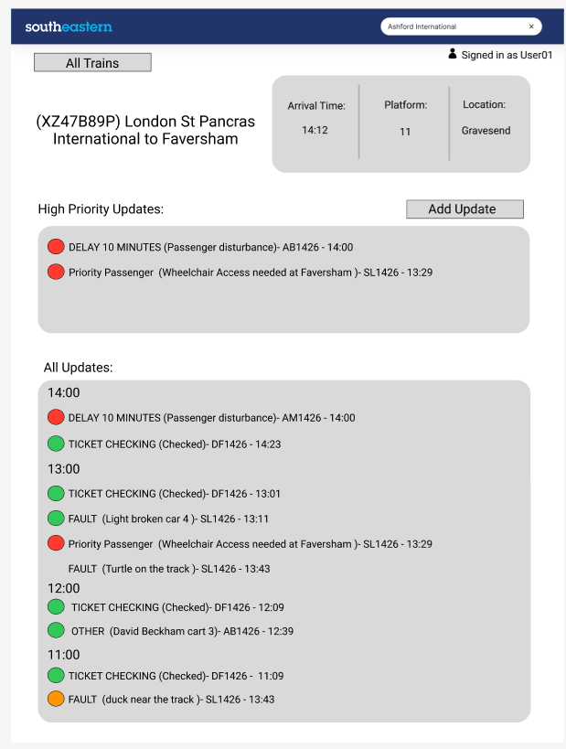
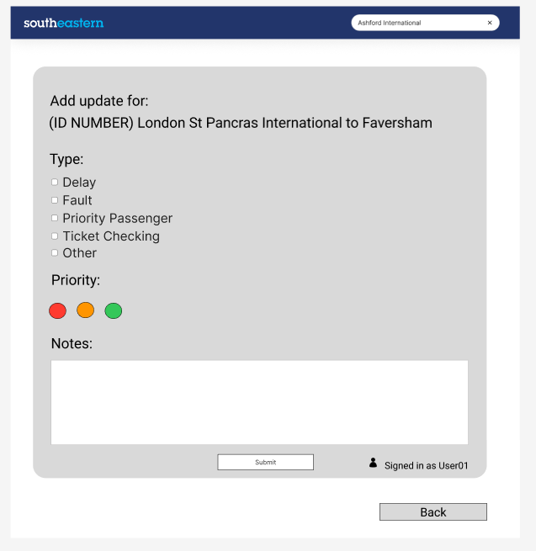
The Design- Overview Page

Slide 7


Add Update
The Design
Overview Page

Slide 8
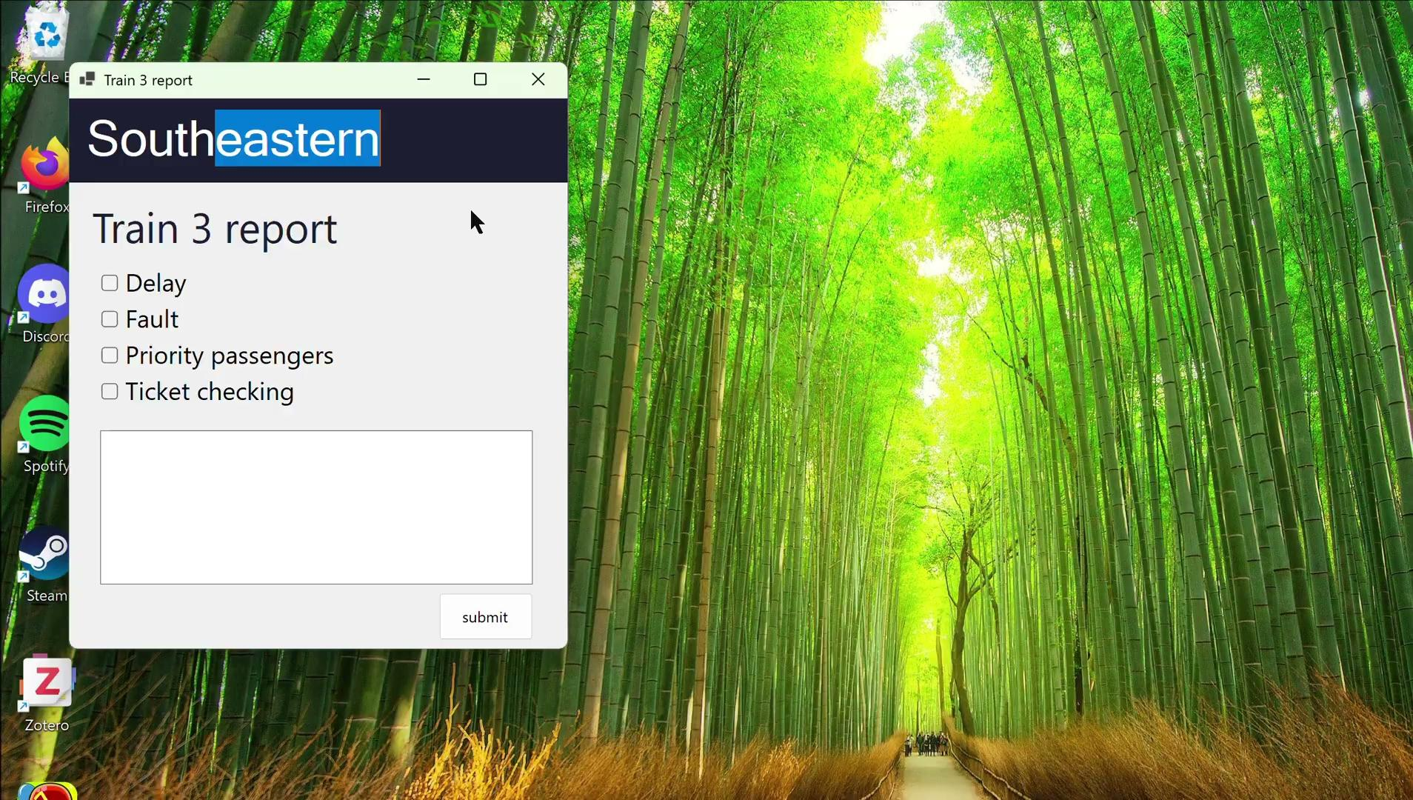
The Design Mobile

Slide 9
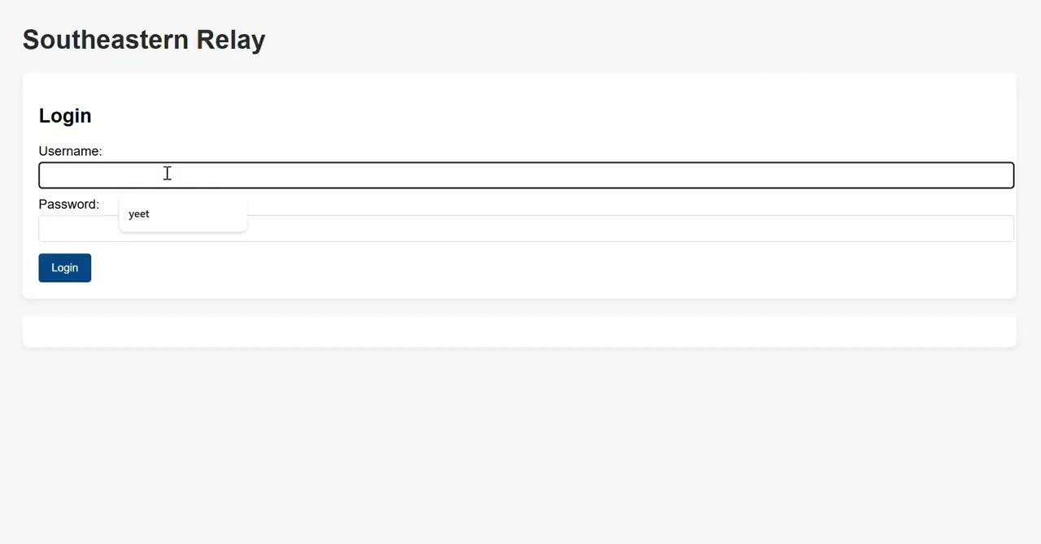
The Design Web

Slide 10
Thank you!

